Slide 1

Quick Cab Ride
Major Project - lI
Problem Statement: “ A reliable and transparent cab booking system connecting passengers with drivers in real time”
Project Group Number: 31
Group Member Details:
Ritik Patel - 0187CS211135
Shreyansh Hirkane - 0187CS211161
Vishal Kurmi - 0187CS211183
Vivek Kumar Rohe - 0187CS191085
Guide Details:
Prof. Anshul Sarawagi

Slide 2
Idea/Approach Details
Abstract:.
Intuitive design
User-friendly interface
Scalable architecture
Develop a web-based cab booking system that connects passengers with drivers in real-time using location-based services. The platform will feature user authentication, ride booking, fare estimation, live tracking, and secure payments. The system will leverage Maps API for navigation, Node.js & Express.js for the backend, and MongoDB for data management. A responsive UI with React.js will ensure a seamless user experience. The goal is to provide a fast, reliable, and transparent ride-hailing solution for both users and drivers.
Describe your Technology stack here:
Front-end : HTML, CSS, JavaScript
Back-end : Express.Js, Node.Js
Database : MongoDB
Frameworks : React.js

Slide 3
Project Requirements
Functional Requirements
Non Functional Requirements
User Module
User registration & authentication
Profile management (name, contact, payment details)
Ride booking (pickup/drop location, fare estimate)
Real-time ride tracking
Payment integration (UPI, card, wallet)
Ride history & feedback system
Driver Module
Driver registration & authentication
Ride request notifications
Navigation assistance (Google Maps API)
Earnings & trip history
Scalability – Handle multiple ride requests simultaneously
Security – Secure user data & payments using encryption
Performance – Fast response time for ride matching & tracking
Usability – User-friendly UI for seamless navigation

Slide 4
Project Requirements
Hardware and Software requirements (Developer)
Hardware and Software requirements (Client)
Hardware Requirements
Processor: Intel i3/i5/i7 or AMD Ryzen 5/7
RAM: Minimum 8GB
Storage: SSD with at least 256GB
Internet Connection: Stable broadband for API testing & deployment
Software Requirements
Development Tools
VS Code / WebStorm (for coding)
Postman (API testing)
Git & GitHub (version control)Code Editor (VS Code)
Programming Languages & Frameworks:
Frontend: React.js, HTML, CSS, JavaScript
Backend: Node.js, Express.js
Database: MongoDB
APIs & Services: Maps API (location tracking)
Payment Gateway (Razorpay/Stripe)
Hardware Requirements
Device Compatibility: Smartphone: Android 8.0+ / iOS 12+ with at least 2GB RAM
GPS Support: Required for real-time location tracking
Storage: Minimal space required for web version; ~100MB for mobile app
Software Requirement
Operating System: Windows (for web users) / Android, iOS (for mobile users)
Web Browser: Chrome, Firefox, Edge, Safari
Internet Connection: Stable broadband or mobile network (4G/5G recommended)

Slide 5
Design
Describe your Use Cases here
Describe your Dependencies / Show stopper here
User Use Cases
User Registration & Login
Book a Ride (enter pickup/drop-off, confirm ride)
Real-Time Ride Tracking
View Fare & Make Payment (UPI, card, wallet)
Cancel Ride (with/without cancellation fee)
Rate & Review Driver
Driver Use Cases
Driver Registration & Login
Accept/Reject Ride Requests
Navigation Assistance (Maps API)
View Trip Earnings & Ride History
Go Online/Offline
Dependencies
Internet Connectivity
Maps API.
Payment Gateway (Razorpay/Stripe
Database (MongoDB)
Authentication System (JWT)
Hosting & Deployment
Showstoppers
API Downtime.
Server Downtime Security
High Latency Issues
Driver Availability

Slide 6
Deployment Details
Describe Deployment Details here
Hosting & Infrastructure
Frontend: Deploy on Vercel, Netlify
Backend: Host on AWS EC2
Database: Use MongoDB Atlas (NoSQL)
Security: Enable SSL/TLS, JWT Auth for authentication.
APIs & Services
Maps API – Location tracking & navigation.
Payment Gateway (Razorpay/Stripe)
Cloud Storage (AWS S3) – Ride data & images.
CI/CD & Monitoring
CI/CD: Automate deployments with GitHub Actions/GitLab CI/CD.

Slide 7
Monetary Support
Financial Requirements
Development Costs
Domain & Hosting: ₹5,000 – ₹15,000/year (GoDaddy, AWS)
Backend & Database: ₹15,000 – ₹50,000/year (AWS EC2, MongoDB Atlas)
APIs & Services: ₹2,000 – ₹10,000/month (Map, Payment Gateway)
Maintenance & Security
SSL Certificate: ₹1,500 – ₹5,000/year
Security Audits: ₹10,000 – ₹50,000 (one-time or periodic)
Marketing & Promotion
Ads & SEO: ₹5,000 – ₹30,000/month (Google, Facebook Ads)
Team & Development
Developer Salaries: ₹40,000 – ₹1,00,000/month (if hiring)
UI/UX Designer: ₹10,000 – ₹50,000 (freelancer or in-house)
Total Estimate: ₹50,000 – ₹3,00,000+ (depending on scale)

Slide 8
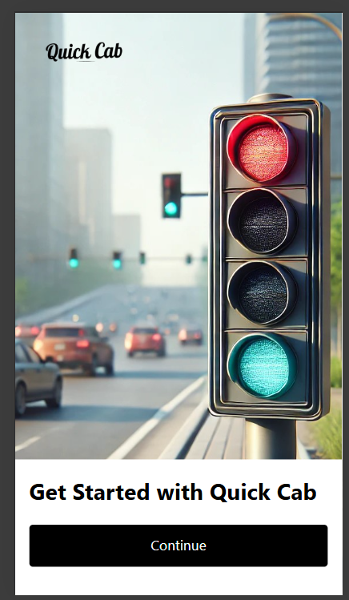
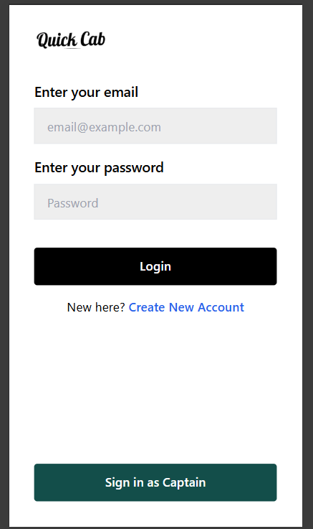
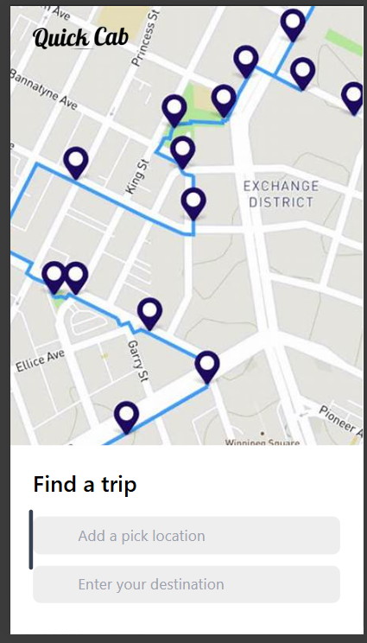
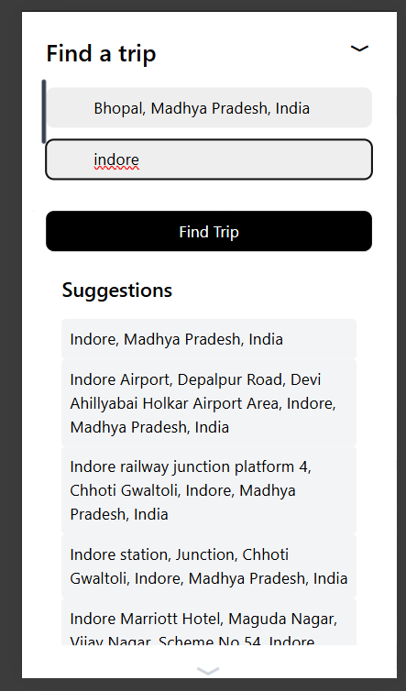
Project Screenshots

Slide 9
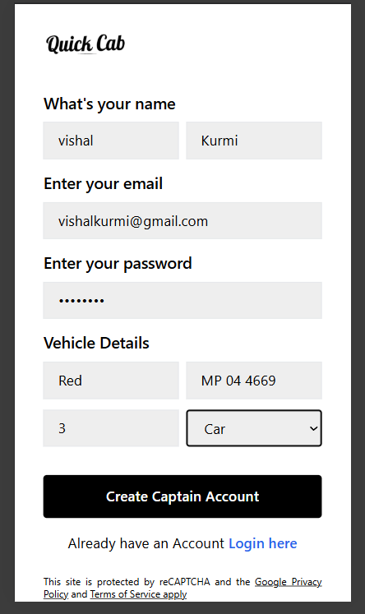
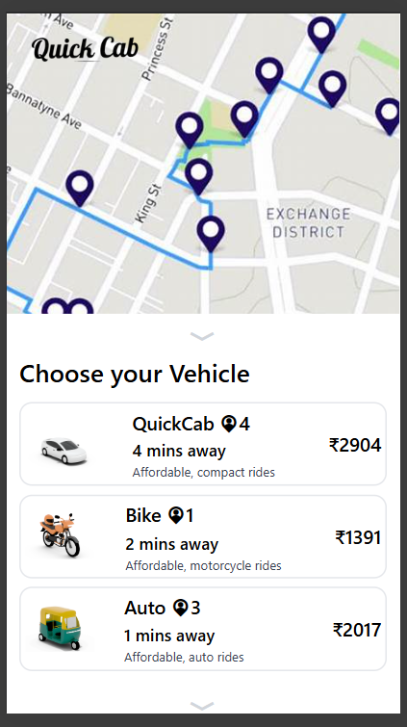
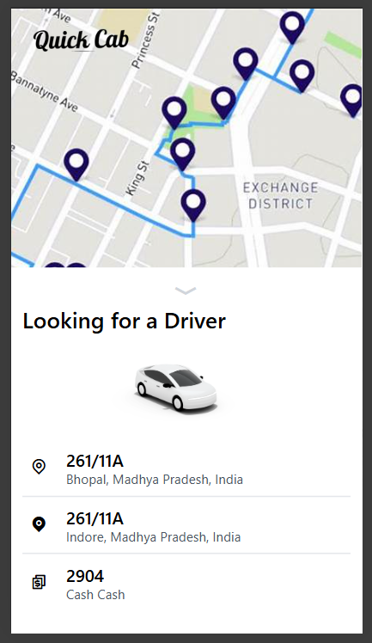
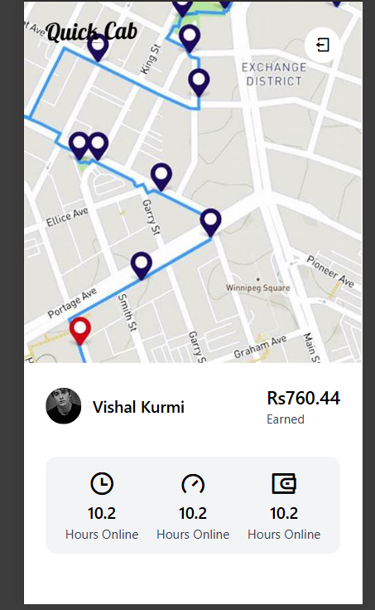
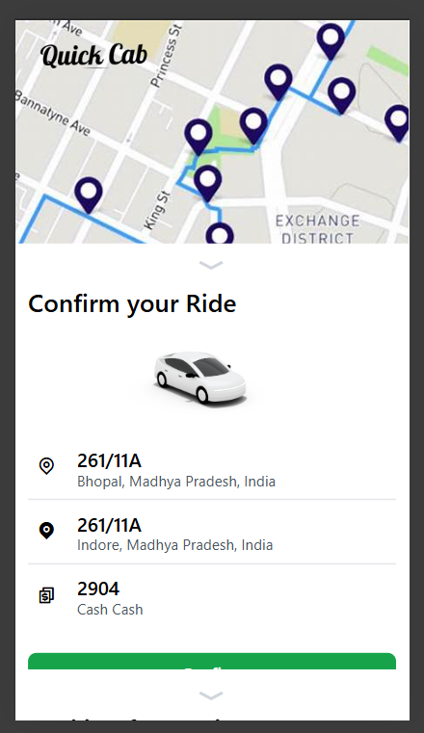
Project Screenshots

Slide 10
T
H
A
N
K
Y
O
U

